Slide 1
Exploring Data Geographically

Slide 2
Scenarios
1. Create a Map view to represent all the states with country.
2. Check your map for south region.
4. Check the sales for south region.
5. Find the state that has highest sales.
6. Represent your sales in USD.
7. Edit color for you map.
8. Show profit for all the states in your map in south region.
9. Find out the name of some states having negative profit.
10.Note down the name of the states having lowest profit and highest profit.

Slide 3
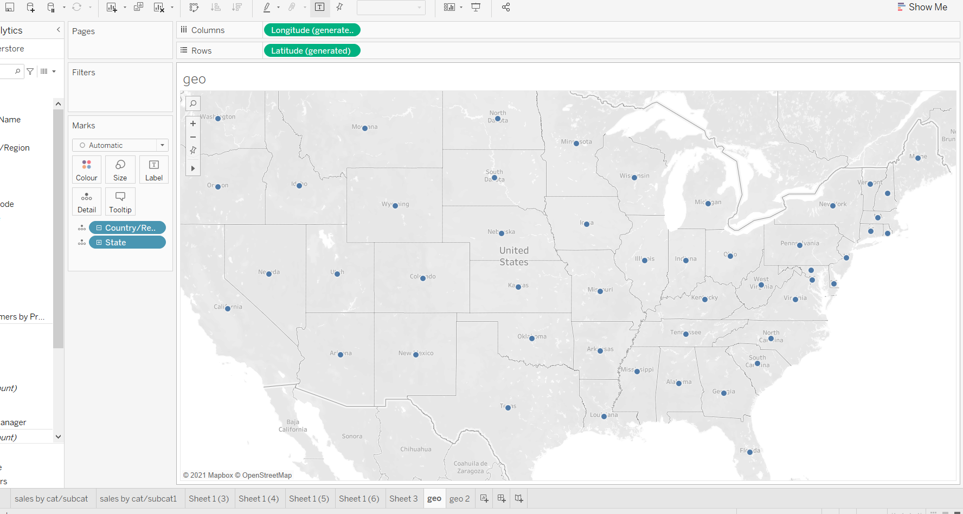
1. Create a Map view to represent all the states with country.

Slide 4
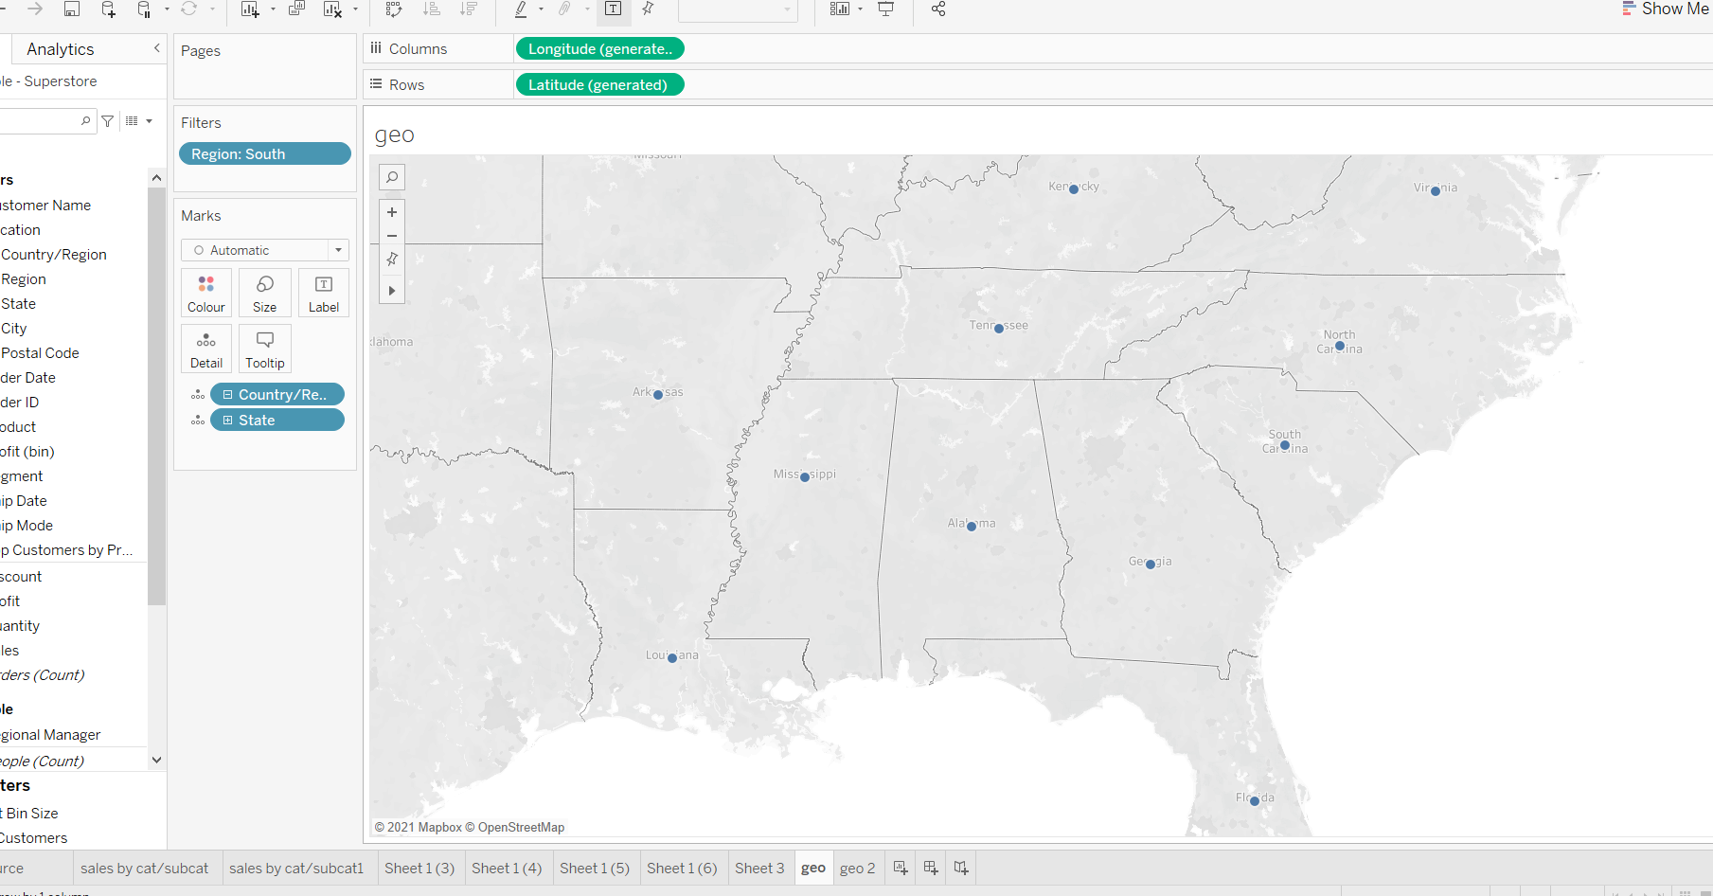
2. Check your map for south region.

Slide 5
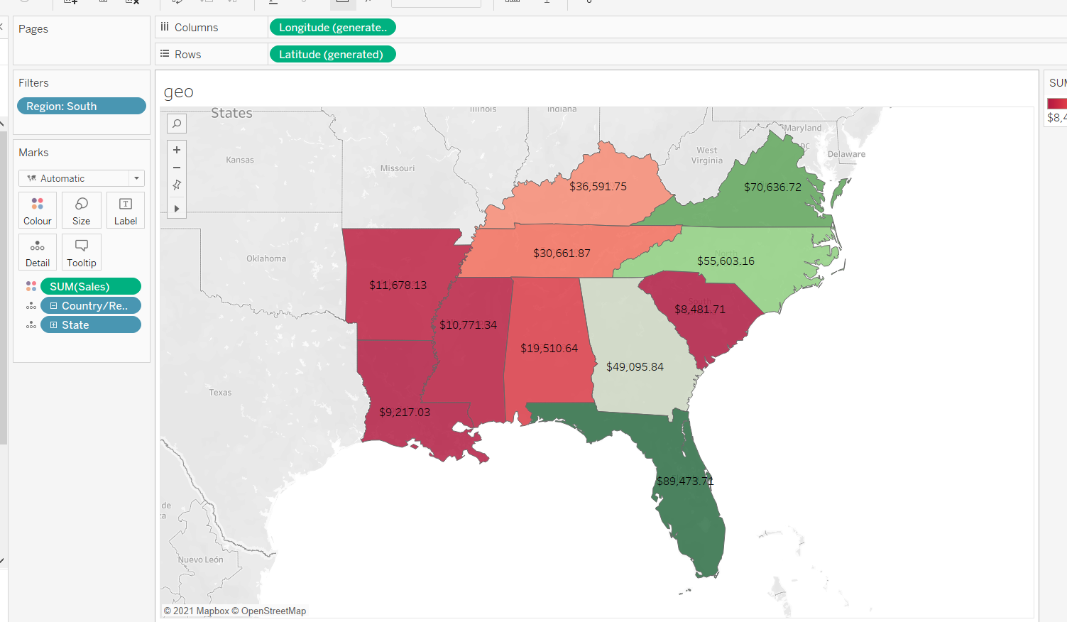
3.

Slide 6
4.

Slide 7
5.
Florida (89,744)
6)

Slide 8
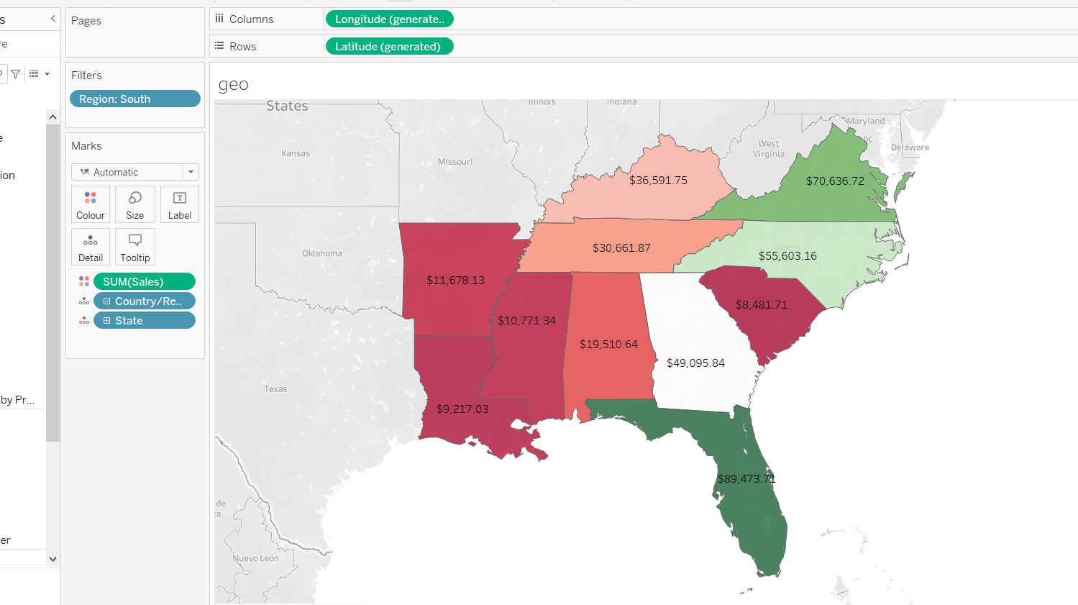
7.

Slide 9
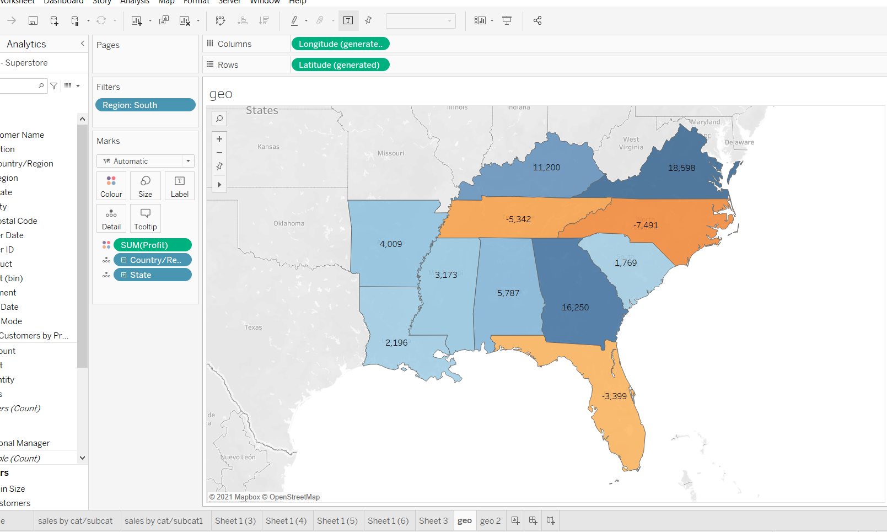
8.

Slide 10
9)
North Carolina
Florida
Tenneesse

Slide 11
10.
Lowest profit → North Carolina
Highest Profit → Virginia

Slide 12
Thank you

